Slide 1

Monitoring and Incident Response Course Presentation
Network Security Monitoring (NSM) Solution: A Case Study of Security Onion

Slide 2
Group 1 Presenters:
Loveth Lumumba Adeh
Anju Devassia
Philbert Kaijage
Ankush
Dhaval Savaliya

Slide 3
Objective
This presentation aims to address the organization's needs and explore the roles, benefits and drawbacks of Security Onion compared to other solutions in the market.

Slide 4
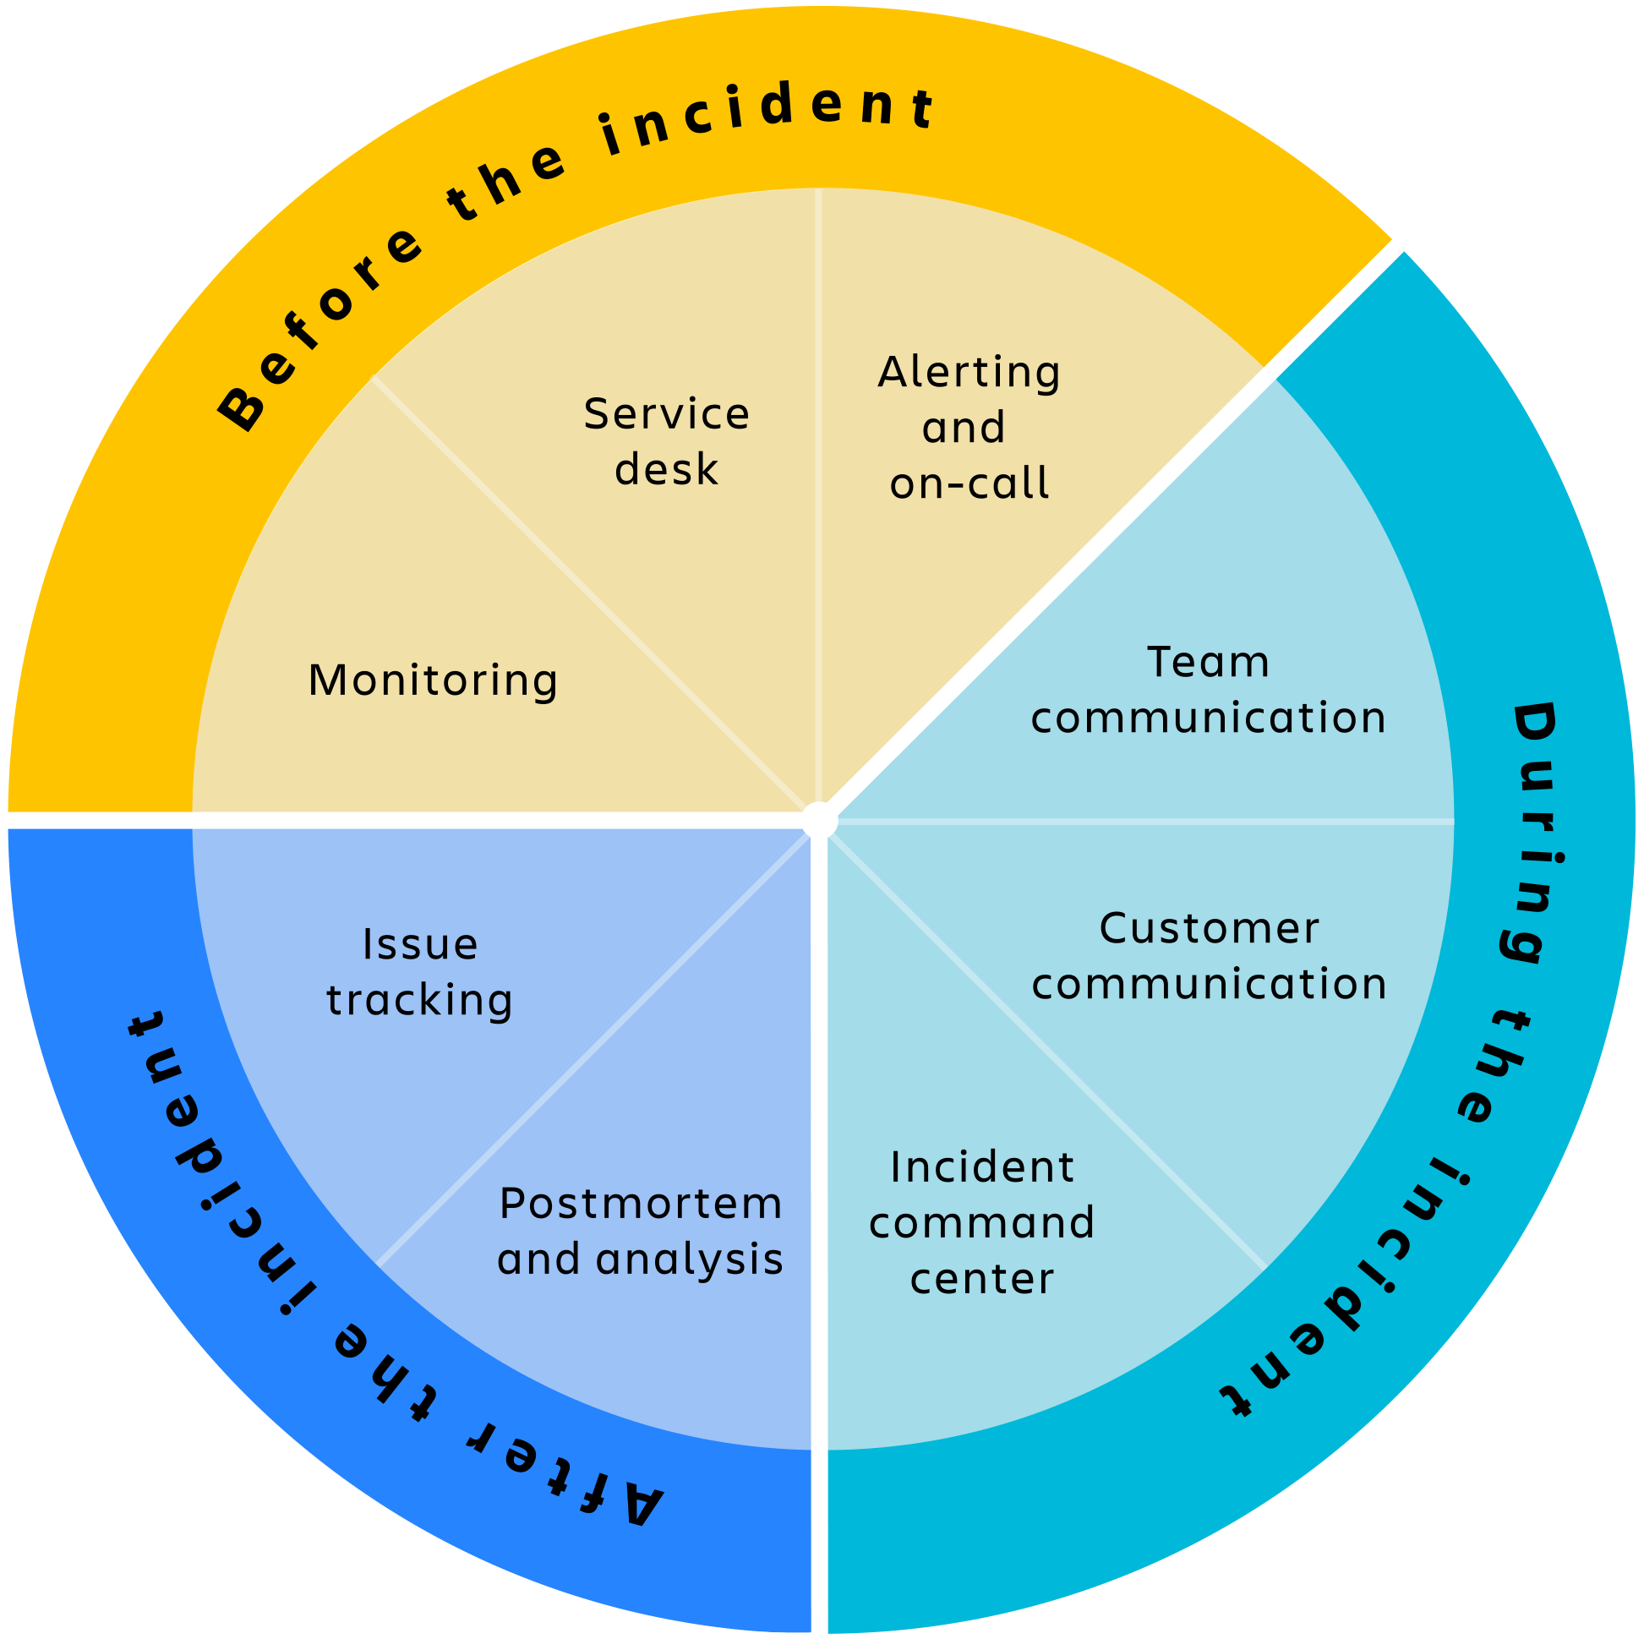
Incident Response and Contingency Planning.
A key component of contingency planning in the fields of cybersecurity and information security is incident response. It explains the systematic approach a business takes to effectively and efficiently manage and react to security issues as they occur. Reduce the effects of security breaches, lower risks, and swiftly resume regular operations are the core goals of incident response.

Slide 5
Roles of Incident Response Team
Threat Detection and Analysis: The team monitors network activity and security logs to detect and analyze potential security incidents promptly.
Incident Response Coordination: They lead the organization's response efforts, ensuring a coordinated and effective approach to mitigate and contain incidents.
Containment and Eradication: The team works to isolate affected systems, remove threats, and prevent further damage during an active incident.
Forensic Investigation: They conduct detailed investigations to determine the cause, extent, and impact of security breaches.
Communication and Reporting: The team communicates incident details to stakeholders and prepares incident reports for management and regulatory authorities.
Lessons Learned and Improvement: After an incident, the team reviews the response process, identifies areas for improvement, and implements measures to enhance future incident handling.
Threat Intelligence Integration: They incorporate threat intelligence to stay informed about the latest threats and improve incident detection and response capabilities.
It is crucial in detecting and mitigating security incidents promptly. Their expertise and coordination enable early threat detection, swift response actions, and effective containment, minimizing the impact of attacks and safeguarding the organization’s assets, data, and reputation.

Slide 6

What is Security Onion?
It is an open-source network security monitoring and intrusion detection system
It has a user-friendly interface and active community support.
Also, scalable and integrates well with existing security tools, making it an effective and cost-efficient solution for enhancing network security.

Slide 7
Security Onion Overview
Packet Capture: Security Onion can capture and store network packets, allowing for in-depth analysis of network traffic and identifying potential threats.
Intrusion Detection: It includes powerful Intrusion Detection System (IDS) tools like Suricata and Snort, which can detect and alert on suspicious or malicious activities within the network.
Log Analysis: Security Onion parses and analyzes various log data, providing valuable insights into system and network activities, facilitating the detection of anomalies and security incidents.
Full Packet Capture (FPC): FPC stores all packets passing through the network, enabling detailed investigations of security incidents after they occur.
Zeek (formerly Bro): Zeek is a network analysis framework that monitors and records network traffic in real-time, assisting in threat detection and behavior analysis.

Slide 8
Benefits of Security Onion
Comprehensive Network Visibility: Ability to monitor network traffic in real-time.
Open-Source Solution: Cost-effective and community-supported.
Scalability: Suitable for small to large-scale networks.
Integrations: Works well with existing security tools.
Active Community: Access to frequent updates and improvements.

Slide 9
Drawbacks of Security Onion
Steeper Learning Curve: Requires training for efficient use.
Resource-Intensive: Demands adequate hardware resources.
Customization: Some customization may be needed for specific network environments.

Slide 10
Analyzing System Logs
It is used to find instances compromised and networks risk in the organization network traffic by analyzes of system logs and data.
Network Intrusion Detection (NIDS)System technologies like Suricata and Snort can be used to scan network traffic for known patterns of malicious activity or signatures, are included in Security Onion.
They generate logs containing information about the observed events, including the source and destination IP addresses, the type of attack, and other pertinent details, when they discover suspicious activity.
These logs can be examined by analysts to determine the type of attacks and take appropriate actions to mitigate them.

Slide 11
Comparison with other Solutions
Suricata and Snort Integration:
Security Onion incorporates both Suricata and Snort, two widely used Network Intrusion Detection Systems (NIDS). This dual integration provides enhanced capabilities for detecting network threats and suspicious activity, giving analysts a broader range of signatures and detection rules to work with.
Zeek (formerly known as Bro) Integration:
Security Onion also includes Zeek, a powerful network analysis framework. Zeek provides detailed insights into network traffic and enriches the NSM data, enabling better understanding and analysis of network events.
Elastic Stack Integration:
Security Onion seamlessly integrates with Elastic Stack (ELK), which provides robust log management, data visualization, and analysis capabilities. This integration allows for centralized storage and analysis of logs, facilitating efficient correlation and investigation of security incidents.
Overall, Security Onion is a compelling NSM solution that stands out due to its comprehensive approach, community support, cost-effectiveness, and flexibility. While other commercial NSM solutions may offer specific features or support options, Security Onion's active community and open-source nature make it an attractive choice for organizations seeking a powerful network security monitoring solution.

Slide 12
Conclusion
Security Onion is a comprehensive Network Security Monitoring (NSM) solution that provides real-time visibility into network traffic and activities to detect and respond to security threats.
Its open-source nature makes it cost-effective and allows for a vibrant community that actively supports and contributes to its development.
Security Onion offers scalability, making it suitable for small to large-scale networks, and integrates well with existing security tools.
The platform provides powerful log analysis capabilities, leveraging NIDS and HIDS tools, firewall logs, syslog, and packet capture analysis to identify incidents of compromise and network threats.
While Security Onion has some drawbacks like a steeper learning curve and resource-intensive demands, its benefits overshadows its challenges.

Slide 13
Reference
Sanders C., Smith J. (2013), Applied Network Security Monitoring.

